Slide 1
Simple Machines: The Inclined Plane
Year 7 Science

Slide 2
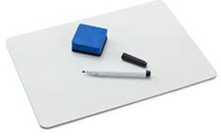
Review
Draw the magnetic field of a bar magnet. | Draw the magnetic field of a horseshoe magnet.
Draw an electromagnet. | Explain the difference between permanent, temporary and electromagnets.

Slide 3
Learning Intentions
Investigating a simple machine such as lever or pulley system

Slide 4
Success criteria
Explain that a simple machine works by reducing the force but increasing the distance.
Define work.
Explain how an incline plane works.
Give examples of inclined planes.

Slide 5
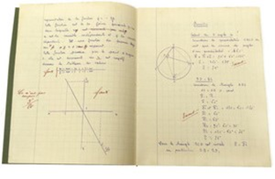
Simple Machines 7/08/2024

Slide 6
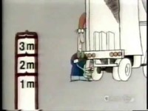

Slide 7
Activity/Worksheet: Inclined Planes

Slide 8
Success criteria
Explain that a simple machine works by reducing the force but increasing the distance.
Define work.
Explain how an incline plane works.
Give examples of inclined planes.

